Slide 1
Задание 1. Используя исторические данные на листе «Timeseries» (см. Задания_1_2.xlsx), построить модель временного ряда. Спрогнозировать ежедневное поведение ряда в следующие 3 мес. Пояснить выбор метода прогнозирования. Привести оценки качества прогноза.

Slide 2
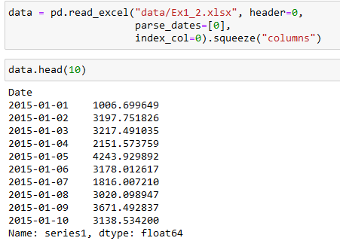
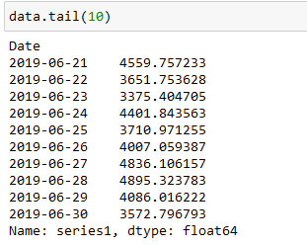
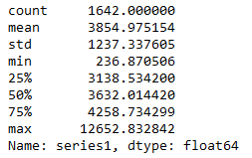
Reading our data and initial review
End of the data
Descriptive statistics
We have 1,642 rows of data for each day from 2015-01-01 to 2019-06-30.

Slide 3
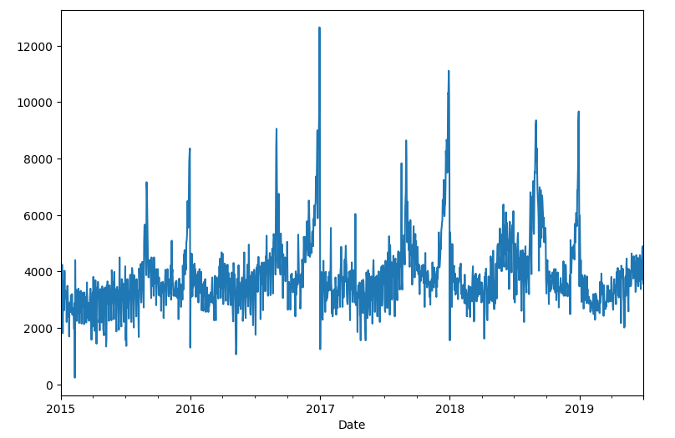
Let's plot this time series data
Data has many splashes, let’s plot it with different rolling windows for noise reducing.

Slide 4
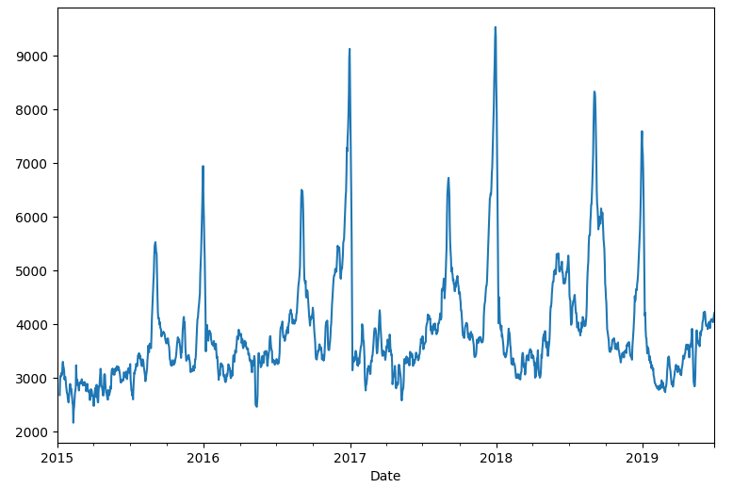
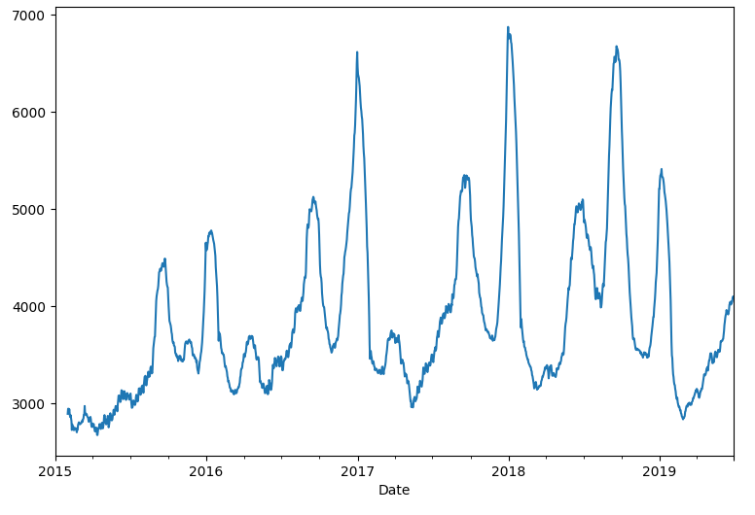
Weekly window
Monthly window
We can see some seasonal dependence in the data. The general trend repeats from year to year. It has the high splashes approximately on September and in the end of the year. Probably we have a deal with some subscriber activities.

Slide 5
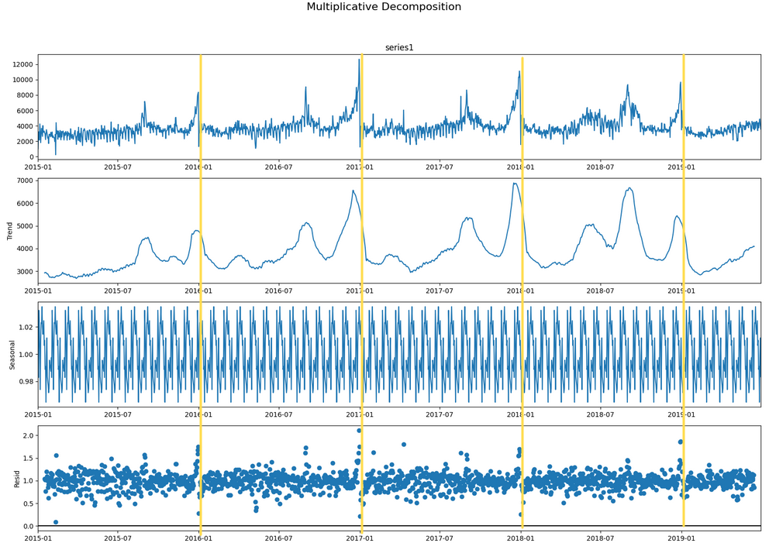
Let's split our data into components (trend, seasonal, residuals)
By eyes we can see seasonal trending. Let's make some stationarity tests with statsmodels python library.

Slide 6
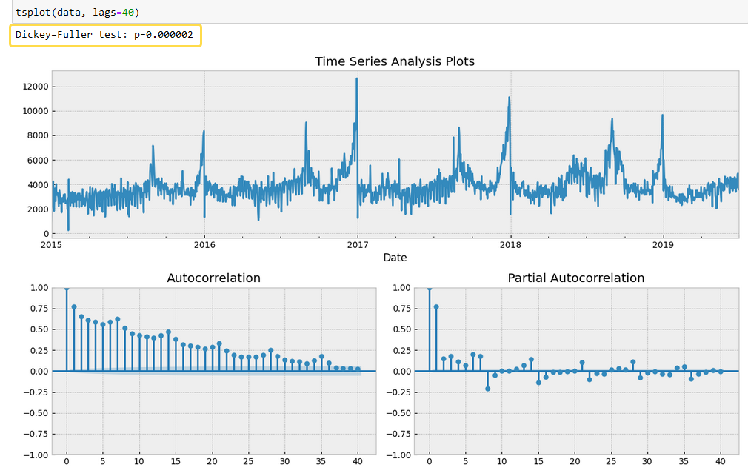
Dickey-Fuller Test
Dickey-Fuller test shows very small p-value (<<<0.05), that rejects the null hypothesis of non-stationarity of the data.
However, on ACF chart we can see season trending of our data. Let's resample our data by months and plot again our ACF lags.

Slide 7
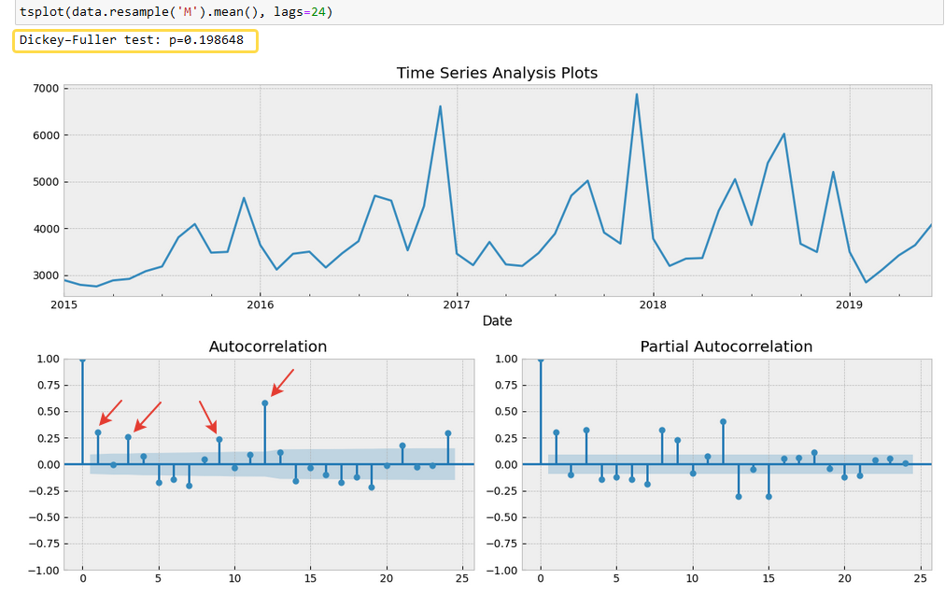
Dickey-Fuller Test (resample data by months, 24 lags plotting)
We can't reject the null hypothesis of series non-stationarity. And we can clearly observe significant lags - 1, 3, 9, 12
In January, March, September and December we have strong seasonally dependencies

Slide 8
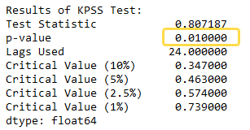
Let's make a KPSS test to be more sure
KPSS test has another null hypothesis, that series is stationary. And with resulting p-value we can reject it.
So, our time series is non-stationary
We have a non-stationary time series. We have to predict a daily values for future 3 months. It's will be a huge season component (365). For this task let's use facebook library Prophet.
It uses additive regression model with four main components:
a piecewise linear logistic growth curve trend;
a yearly seasonal component modelled using Fourier series;
a weekly seasonal component created using dummy variables;
a user-provided list of important holidays.

Slide 9
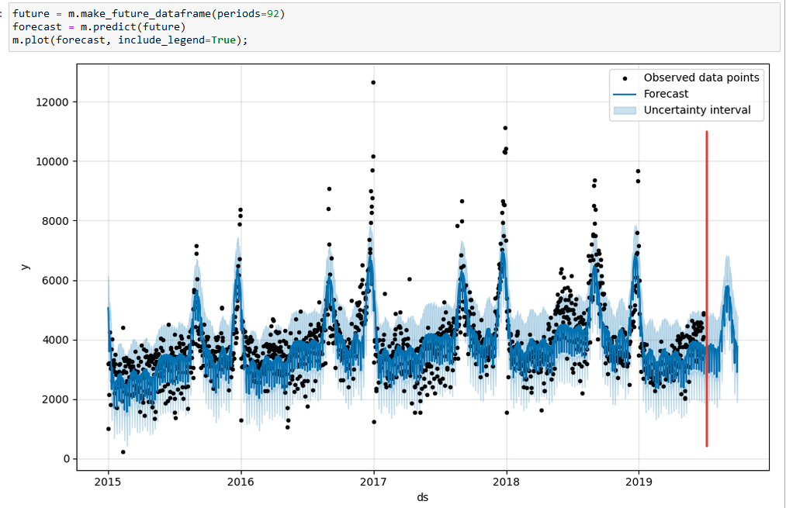
Forecasting
We have to predict 3 months after June. It is a 92 days
Looks good. The algorithm caught some dependencies. Let’s look closer on the next slides

Slide 10
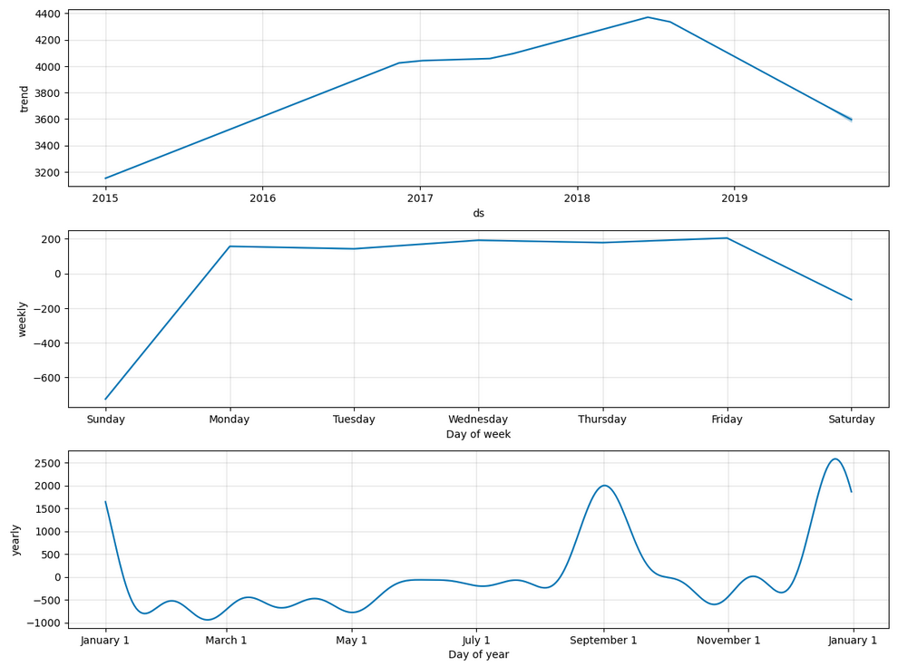
Plot the components, that the model found in data
Our model has found some dependencies:
- Weekday values are higher than weekend values
- Values on January, September and December also higher than in other months.

Slide 11
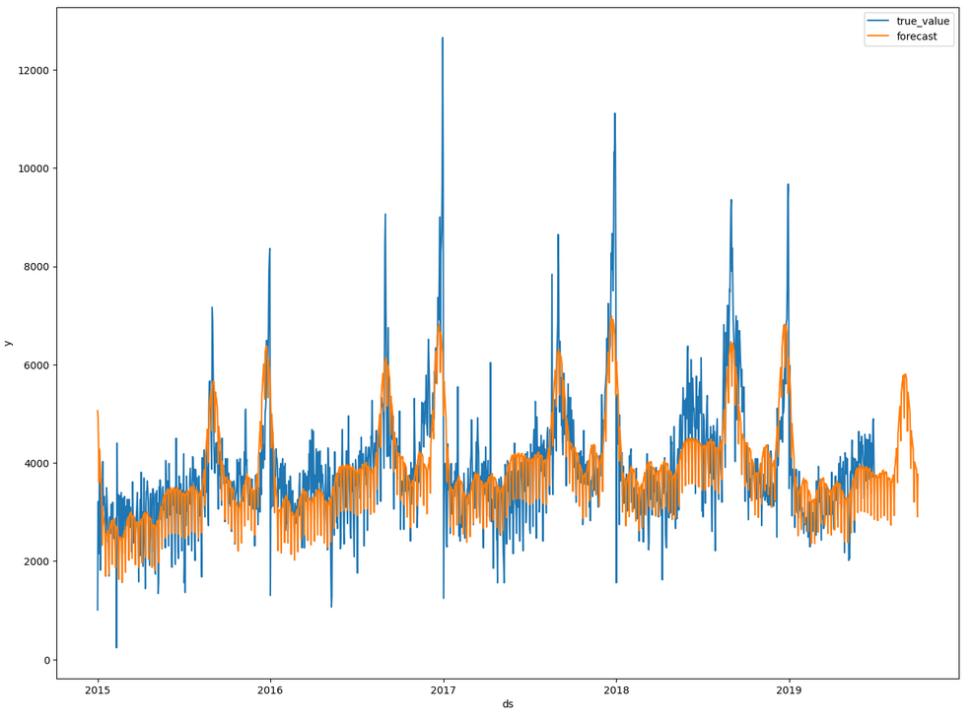
Plot our forecasts and true data on a single chart

Slide 12
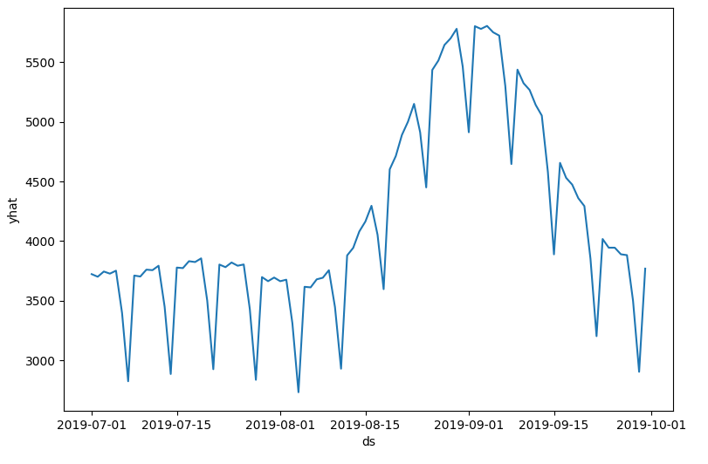
Let's observe just our forecasting
Look's good, it captures the weekly dependencies and the splash in September

Slide 13
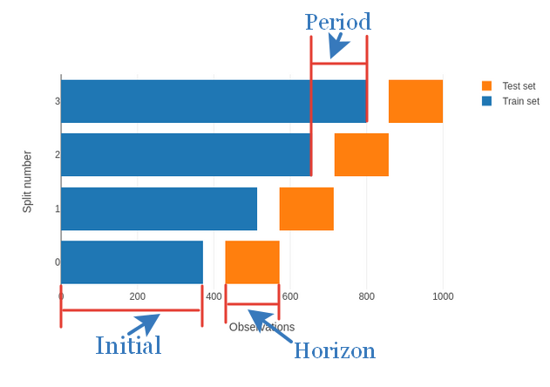
Now, validate our model with time series cross validation.
An example of how it works
Let's perform cross validation on our data with the following parameters

Slide 14
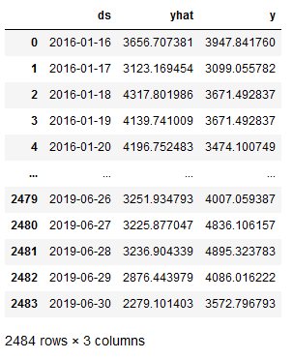
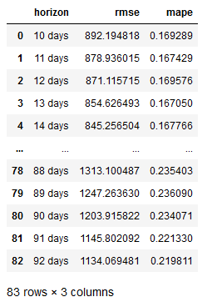
We have got the following results
Metrics calculation
MAPE metric has values from 16 to 23 percent error.
Let's display MAPE metric as a function of horizon length

Slide 15
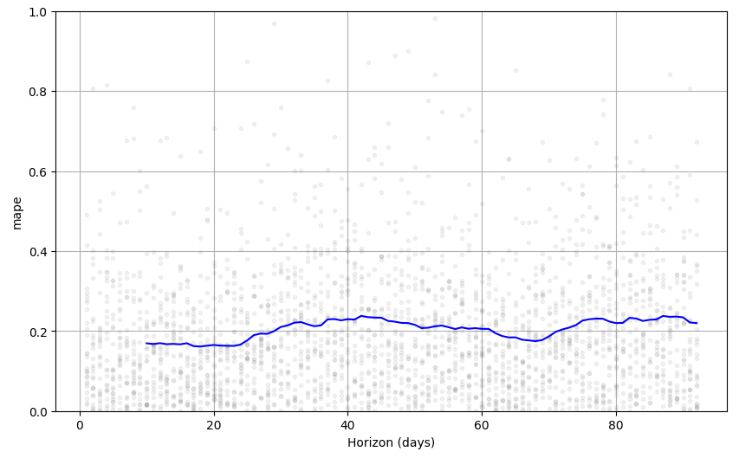
MAPE as a function of horizon length
We have got approximately 20% error in 3 months forecasting.
Thanks for watching!

